Slide 1
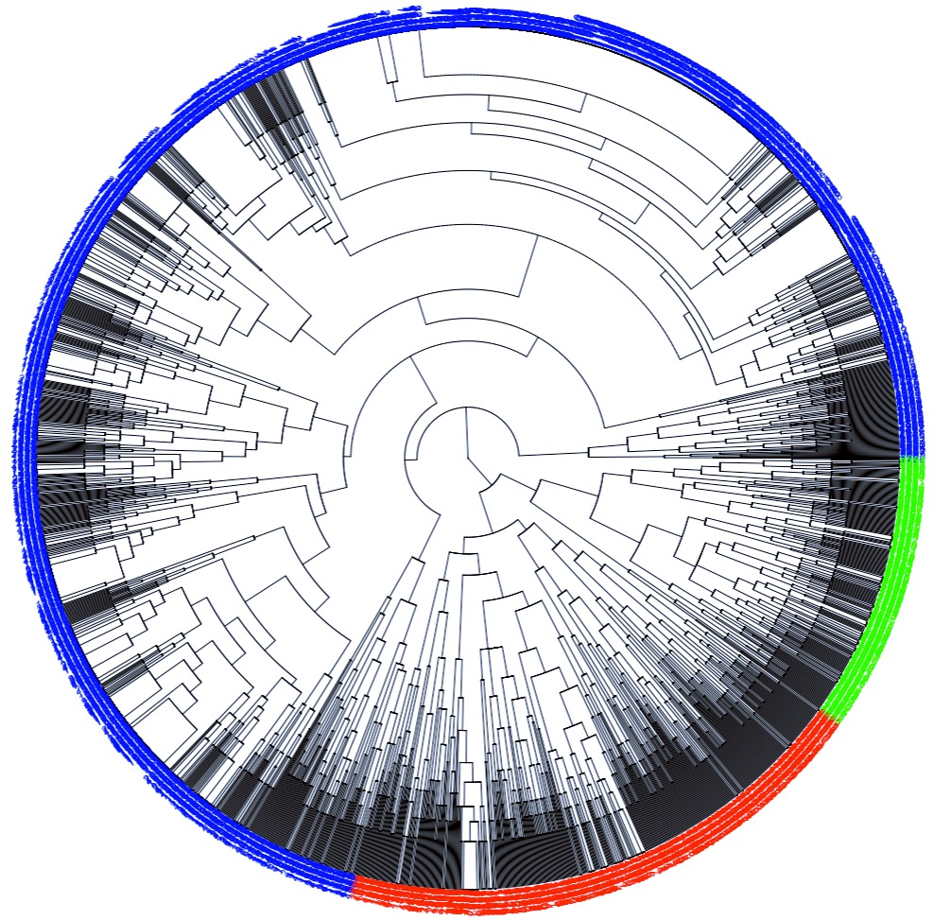
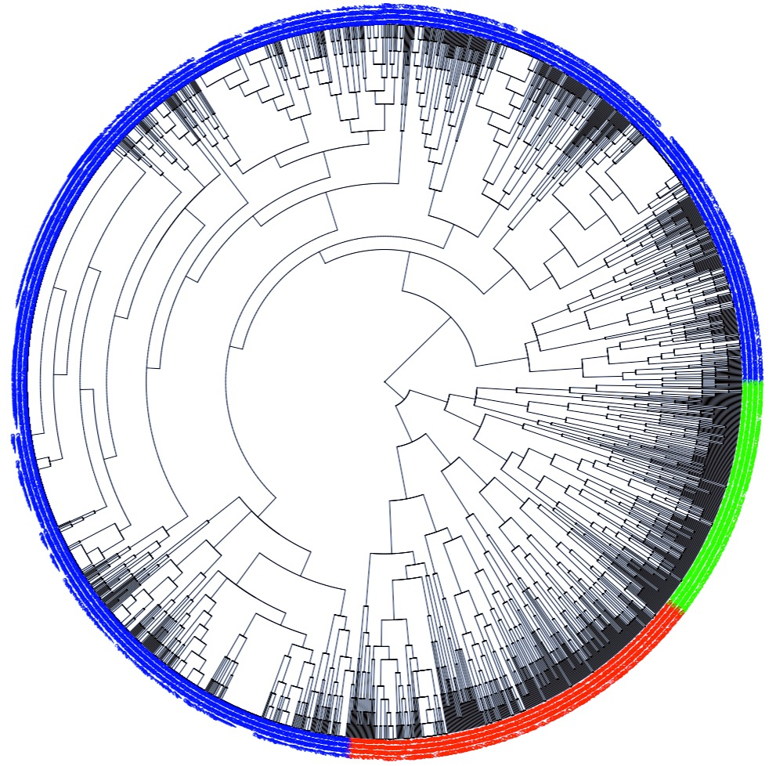
C1
C2
C3
Figure XXa: Hierarchical Clustering 3 Clusters
Euclidean Metric
Figure XXb: Hierarchical Clustering 3 Clusters
Manhattan Metric

Slide 2
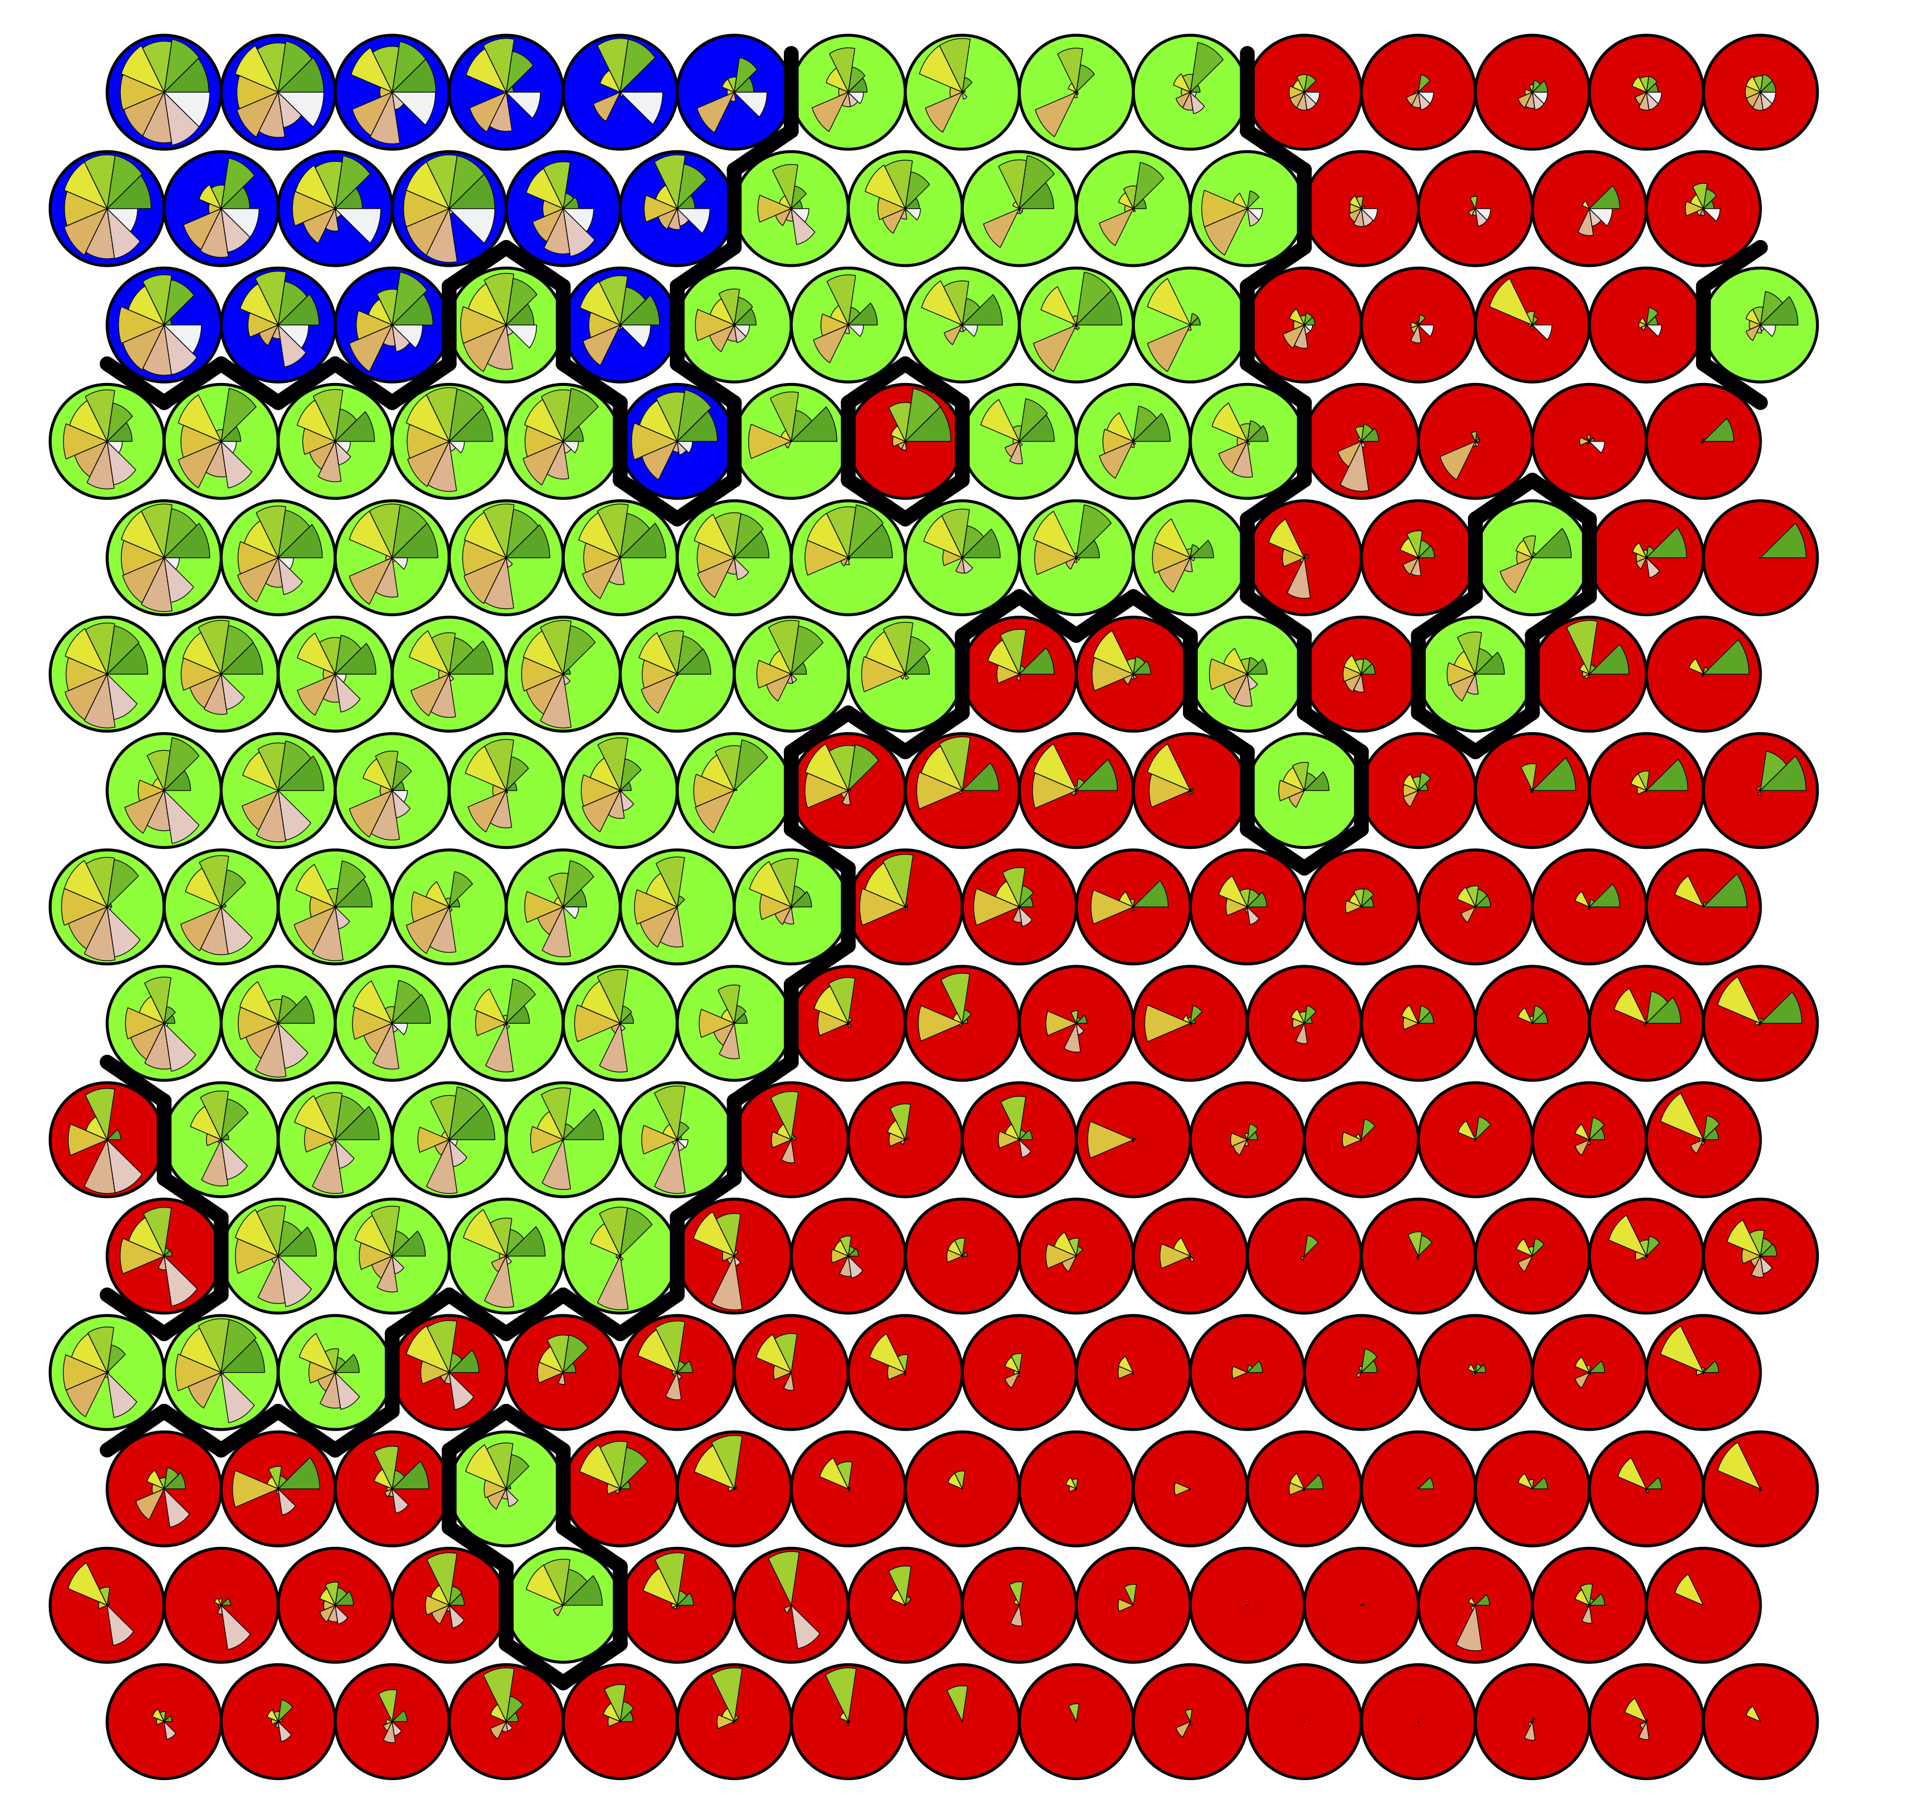
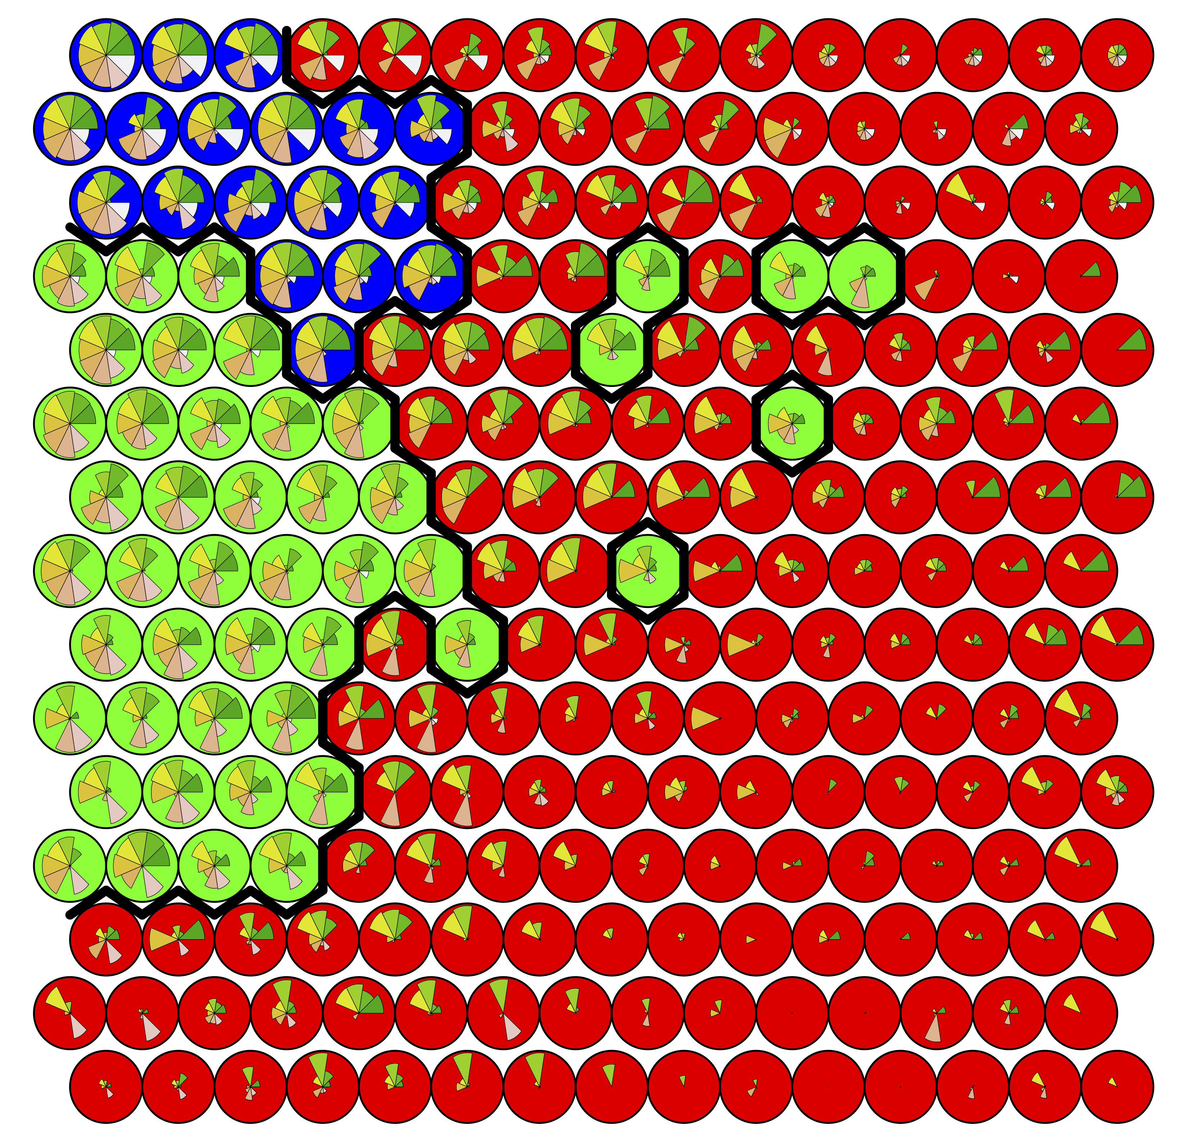
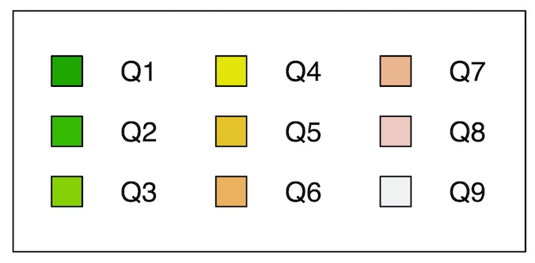
Figure XXa: Self Organizing Map
15x15 lattice, hexagonal topology
Euclidean Metric
Figure XXb: Self Organizing Map
15x15 lattice, hexagonal topology
Manhattan Metric
C1
C2
C3

